Slide 1

Department of Information Technology
Nonlinear Data Structure
Data Structure 01CE0301 / 3130702
Unit#3
Ravikumar Natarajan

Slide 2
Unit#3: Nonlinear Data Structure
Highlights
Trees
Graphs

Slide 3
Unit#3: Nonlinear Data Structure
Graphs and their understanding
Matrix representations of a given graph
Depth First Search (DFS)
Breadth First Search (BFS)
Minimum Spanning Trees Algorithms (Prims, Kruskal, Dijkstra)
Path Matrix
Warshall’s Algorithm
Till Now
Trees
Graphs

Slide 4
Unit#3: Nonlinear Data Structure
Graphs and their understanding
Matrix representations of a given graph
Depth First Search (DFS)
Breadth First Search (BFS)
Minimum Spanning Trees Algorithms (Prims, Kruskal, Dijkstra)
Path Matrix
Warshall’s Algorithm
Up Next
Trees
Graphs

Slide 5
Unit#3: Nonlinear Data Structure
Shortest Path Algorithms
Minimum spanning tree
Dijkstra’s algorithm
Warshall’s algorithm

Slide 6
Unit#3: Nonlinear Data Structure
A spanning tree of a connected, undirected graph G is a sub-graph of G which is a tree that connects all the vertices together.
A B
Spanning Tree
C
D
A
B
A
B
A
B
A
B
C
D
C
D
C
D
C D
And many more…

Slide 7
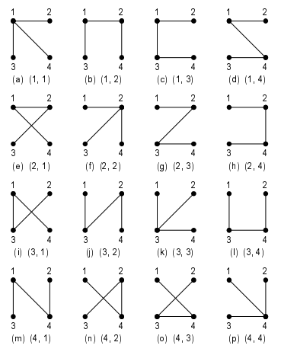
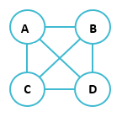
Unit#3: Nonlinear Data Structure
A spanning should satisfy V – 1 edges
HOW MANY NUMBER OF SPANNING TREE POSSIBILITIES?
n^{(n-2)} where n is number of vertices
Spanning Tree
All 16 spanning trees of K4

Slide 8
Unit#3: Nonlinear Data Structure
A minimum spanning tree (MST) is defined as a spanning tree with weight less than or equal to the weight of other spanning tree.
3
A B
4
7
5
6
Minimum Spanning Tree
C
2
D
A
3
B
A
3
B
A
3
B
A
3
B
4
7
5
6
5
4
C
D
C
D
C
2
Cost:10
D
C
2
Cost:9
D
Cost:14
Cost:14

Slide 9
Unit#3: Nonlinear Data Structure
Network Designs. Like telephone network, to choose least costly path.
To ﬁnd airline routes. Vertices denote cities, edges represent routes between cities.
MSTs are applied in routing algorithm for ﬁnding the most eﬃcient path.
Applications of MST

Slide 10
Unit#3: Nonlinear Data Structure
Kruskal's Algorithm
Minimum Spanning Tree
Prim's Algorithm
Algorithms
Minimum Spanning Tree
Shortest Path from Src→Dest

Slide 11
Unit#3: Nonlinear Data Structure
Kruskal's algorithm is a minimum spanning tree algorithm that takes a graph as input and finds the subset of the edges of that graph which
form a tree that includes every vertex
has the minimum sum of weights among all the trees that can be formed from the graph
Kruskal performs better in typical situations (sparse graphs) and is easier to implement because it uses disjoint sets and simpler data structures.
It falls under a class of algorithms called greedy algorithms that find the local optimum in the hopes of finding a global optimum.
Kruskal's Algorithm

Slide 12
Unit#3: Nonlinear Data Structure
Problem: Find Minimum Spanning Tree of a Graph
F
3
10
C
Kruskal's Algorithm
4
3
A
6
8
4
5
B
D
4
2
4
H
1
3
E
G
3

Slide 13
Initialize:
Sort the edges by increasing edge weight
Unit#3: Nonlinear Data Structure
Edge | Ew
(D,E) | 1
(D,G) | 2
(E,G) | 3
(C,D) | 3
(G,H) | 3
(C,F) | 3
(B,C) | 4
(B,E) | 4
(B,F) | 4
(B,H) | 4
(A,H) | 5
(D,F) | 6
(A,B) | 8
(A,F) | 10
F
C
Kruskal's Algorithm: Solution Steps
A
B
D
H
G
E
S : { }

Slide 14
Select first |V|–1 edges which do not generate a cycle
Unit#3: Nonlinear Data Structure
Edge | Ew
(D,E) | 1
(D,G) | 2
(E,G) | 3
(C,D) | 3
(G,H) | 3
(C,F) | 3
(B,C) | 4
(B,E) | 4
(B,F) | 4
(B,H) | 4
(A,H) | 5
(D,F) | 6
(A,B) | 8
(A,F) | 10
F
C
Kruskal's Algorithm: Solution Steps
A
B
D
H
G
E
S :

Slide 15

First |V|–1 edges selected Total Cost = 21
Unit#3: Nonlinear Data Structure
Edge | Ew
(D,E) | 1 | √
(D,G) | 2 | √
(E,G) | 3 | χ
(C,D) | 3 | √
(G,H) | 3 | √
(C,F) | 3 | √
(B,C) | 4 | √
(B,E) | 4 | χ
(B,F) | 4 | χ
(B,H) | 4 | χ
(A,H) | 5 | √
(D,F) | 6 | -
(A,B) | 8 | -
(A,F) | 10 | -
F
3
C
Kruskal's
3
A
4
Algorithm: Solution
5
B
D
2
H
1
3
E
G
S : { (D,E),(D,G),(C,D),(G,H),(C,F),(B,C),(A,H) }

Slide 16

Unit#3: Nonlinear Data Structure
F
3
F
3
10
C
C
Kruskal's Algorithm: Solution
4
3
3
A
6
A
8
4
4
5
B
D
5
B
D
4
2
2
4
H
1
H
1
3
E
3
E
G
3
G

Slide 17
1. Create a forest in such a way that every vertex is a separate tree.
Unit#3: Nonlinear Data Structure
Create a priority queue Q that contains all the edges of the graph.
Repeat steps 4 and 5 while Q is not empty
Remove and edge from Q
IF the edge obtained in step 4 connects two different trees, then add it to the forest (combining two trees to one tree) ELSE discard the edge.
End.
Kruskal's Algorithm

Slide 18
Unit#3: Nonlinear Data Structure
Time Complexity
The time complexity Of Kruskal's Algorithm is: O(E log V).
Applications
In order to layout electrical wiring
In computer network (LAN connection)
Time complexity
& Applications of Kruskal's Algorithm

Slide 19
Unit#3: Nonlinear Data Structure
Prim's Algorithm is used to find the minimum spanning tree from a graph. Prim's algorithm finds the subset of edges that includes every vertex of the graph such that the sum of the weights of the edges can be minimized.
Prim's algorithm starts with the single node and explore all the adjacent nodes with all the connecting edges at every step. The edges with the minimal weights causing no cycles in the graph got selected.
Prim’s algorithm is significantly faster in the limit when you’ve got a really dense graph (many more edges than vertices)
Prim’s algorithm uses adjacency matrix, binary heap or Fibonacci heap.
Prim's Algorithm

Slide 20
Unit#3: Nonlinear Data Structure
Problem: Find Minimum Spanning Tree of a Graph, Find Optimal path from D to A
F
3
10
C
Prim's Algorithm
4
3
A
6
8
4
5
B
D
4
2
4
H
1
3
E
G
3

Slide 21
Initialize
Unit#3: Nonlinear Data Structure
F
C
Prim's Algorithm: Solution Steps
 | Vs | Dv | Pv
A | - | ∞ | -
B | - | ∞ | -
C | - | ∞ | -
D | - | ∞ | -
E | - | ∞ | -
F | - | ∞ | -
G | - | ∞ | -
H | - | ∞ | -
A
B
D
H
G
E

Slide 22
Start with node Update distances of adjacent, unselected nodes Select node with minimum distance
Unit#3: Nonlinear Data Structure
 | Vs | Dv | Pv
A | u | ∞ | -
B | u | ∞ | -
C | u | ∞ | -
D | T | 0 | -
E | u | ∞ | -
F | u | ∞ | -
G | u | ∞ | -
H | u | ∞ | -
F
C
Prim's Algorithm: Solution Steps
A
B
D
H
G
E
u : Unseen vertex f : Fringe vertex T : Tree vertex

Slide 23
Cost of Minimum Spanning Tree
Σ Dv = 21
Unit#3: Nonlinear Data Structure
F
3
 | Vs | Dv | Pv
A | T | 5 | H
B | T | 4 | E
C | T | 3 | D
D | T | 0 | -
E | T | 1 | D
F | T | 3 | C
G | T | 2 | D
H | T | 3 | G
C
Prim's Algorithm: Solution
3
A
5
B
D
4
2
H
1
3
E
G
Path From D → A: D→G→H→A

Slide 24
Unit#3: Nonlinear Data Structure
F
3
F
3
10
C
C
Prim's
3
3
A
4
6
A
Algorithm: Solution
8
4
5
B
D
5
B
D
4
2
2
4
4
H
1
H
1
3
E
3
E
G
3
G

Slide 25
1. Select a starting vertex.
Unit#3: Nonlinear Data Structure
Repeat steps 3 and 4 until there are fringe vertices.
Select an edge e connecting the tree vertex and fringe vertex that has minimum weight.
Add the selected edge and the vertex to the minimum spanning tree T.
End.
Prim's Algorithm

Slide 26
Unit#3: Nonlinear Data Structure
Time Complexity
The time complexity Of Kruskal's Algorithm is: O(E+V.log(V)).
Applications
Path finding
Travelling salesman problem
Cluster analysis
Network for roads and rail tracks
Time complexity
& Applications of Prims Algorithm

Slide 27

Unit#3: Nonlinear Data Structure
Given Graph
8
7
B
D
G
4
9
2
Example
A
4
14
I
11
E
8
7
6
10
C
F
H
1
2

Slide 28
Unit#3: Nonlinear Data Structure
Dijkstra's Algorithm
Single-source Shortest Path
Warshall's Algorithm
All pair Shortest Path
Algorithms

Slide 29
Unit#3: Nonlinear Data Structure
Dijkstra's algorithm - is a solution to the
single-source shortest path problem in graph theory.
Works on both directed and undirected graphs.
However, all edges must have nonnegative weights.
It works only for connected graphs
The algorithm predominantly follows Greedy approach for finding locally optimal solution. But, it also uses Dynamic Programming approach for building globally optimal solution, since the previous solutions are stored and further added to get final distances from the source vertex.
Relaxation: If (distance(u) + cost(u,v) < distance(v)) then
distance (v) = distance (u) + cost (u,v)
Dijkstra's Algorithm

Slide 30

Unit#3: Nonlinear Data Structure
Problem:
Single-Source Shortest Path Problem
The problem of ﬁnding shortest paths from a source vertex T₁ to all other vertices in the graph.
Dijkstra's Algorithm
2
T₂
T₅
10
8
T₁
1
4
7
9
3
T₄
T₆
2

Slide 31
Step1: Distance to source vertex is zero Step2: Set all other distances to inﬁnity
Unit#3: Nonlinear Data Structure
Step3: S, the set of visited vertices is initially empty
Step4: Q, the queue initially contains all vertices and initial distances
Step5: Repeat step 6 to 8 while the queue Q is not empty Step6: Select the element of Q with the min. distance: Ti Step7: Add Ti to list of visited vertices S.
Step8: For all V ∈ neighbors[Ti]
Check dist[V] > dist[Ti] + w(Ti, V) if new shortest path found
set new value of shortest path
Dijkstra's Algorithm

Slide 32
Unit#3: Nonlinear Data Structure
∞
∞
Initialize
T₂
T₅
Q:
T₁ T₂ T₄ T₅ T₆
0 ∞ ∞ ∞ ∞
0
T₁
Dijkstra's Algorithm: Solution Steps
T₄
T₆
∞
∞
S: { }

Slide 33
Unit#3: Nonlinear Data Structure
∞
∞
T₂
T₅
Q:
T₁ | T₂ | T₄ | T₅ | T₆
0 | ∞ | ∞ | ∞ | ∞
0
T₁
Dijkstra's Algorithm:
Solution Steps
T₄
T₆
∞
∞
S: {T₁
}

Slide 34
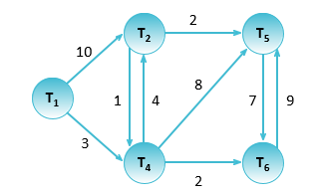
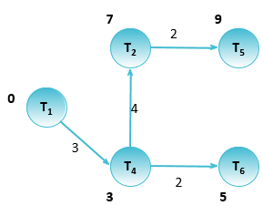
Unit#3: Nonlinear Data Structure
Q:
T₁ T₂ T₄ T₅ T₆
0 | ∞ ∞ ∞ ∞
10 7 |  | 3 | ∞ ∞
 |  | 11 11 |  | 5
 | 7
 |  |  | 9
Dijkstra's Algorithm: Solution
S: {T₁ , T₄ , T₆ , T₂ , T₅}

Slide 35
Unit#3: Nonlinear Data Structure
Time and Space Complexity of Dijkstra's Algorithm
Time Complexity: O(E Log V)
where, E is the number of edges and V is the number of vertices.
Space Complexity: O(V)

Slide 36
Unit#3: Nonlinear Data Structure
Applications of Dijkstra's Algorithm
To find the shortest path
In social networking applications
In a telephone network
To find the locations in the map

Slide 37
Unit#3: Nonlinear Data Structure
Given Graph
8
7
B
D
G
4
9
2
Example
A
4
14
I
11
E
8
7
6
10
C
F
H
1
2

Slide 38
Unit#3: Nonlinear Data Structure
A path matrix is a matrix representing a graph where each value in m’th row and n’th column project whether there is a path from m to n.
The path may be direct or indirect. It may have a single edge or multiple edge.
Path Matrix
k

Slide 39
Unit#3: Nonlinear Data Structure
G = (V,E)
A : adjacency matrix
P = A + A2 + A3 + …
Path Matrix
P0,P1,P2, … Pn:
P [i][j] = 1 { if there is a path from v to v , path should
k i j
not use any other vertex except v₁,v₂,…, v_{k}}
P [i][j] = 0 {Otherwise}
k

Slide 40
Unit#3: Nonlinear Data Structure
15
1
2
5
5 50
5 15
30
3
4
15
Path Matrix

Slide 41
P_{k}[i][j] = 1
Unit#3: Nonlinear Data Structure
Floyd–Warshall algorithm is an algorithm for finding the shortest paths in a weighted graph with positive or negative edge weights (but with no negative cycles).
It does so by comparing all possible paths through the graph between each pair of vertices and that too with O(V³) comparisons in a graph.
Warshall’s Algorithm
iff P [i][j] = 1
k-1
or P [i][k] = 1 and P [k][j] = 1
k-1 k-1
P [i][j] = P [i][j] ᴠ ( P
k k-1
[i][k] ᴧ P
[k][j] )
k-1
k-1

Slide 42
For a graph with N vertices:
Step 1: Initialize the shortest paths between any 2 vertices with Infinity.
Step 2: Find all pair shortest paths that use 0 intermediate vertices, then find the shortest paths that use 1 intermediate vertex and so on.. until using all N vertices as intermediate nodes.
Step 3: Minimize the shortest paths between any 2 pairs in the previous operation.
Step 4: For any 2 vertices (i,j) , one should actually minimize the distances between this pair using the first K nodes, so the shortest path will be: min(dist[i][k]+dist[k][j],dist[i][j]).
dist[i][k] represents the shortest path that only uses the first K vertices, dist[k][j] represents the shortest path between the pair k,j. As the shortest path will be a concatenation of the shortest path from i to k, then from k to j.
Warshall’s Algorithm

Slide 43
Floyd-Warshall(w, n) // w: weights, n: number of vertices
{
for i = 1 to n do // initialize, D (0) = [wij]
for j = 1 to n do
{
d[i, j] = w[i, j];
}
for k = 1 to n do // Compute D (k) from D (k-1)
for i = 1 to n do
for j = 1 to n do
if (d[i, k] + d[k, j] < d[i, j])
{
d[i, j] = d[i, k] + d[k, j];
}
return d[1..n, 1..n];
}
Warshall’s Algorithm Pseudocode

Slide 44
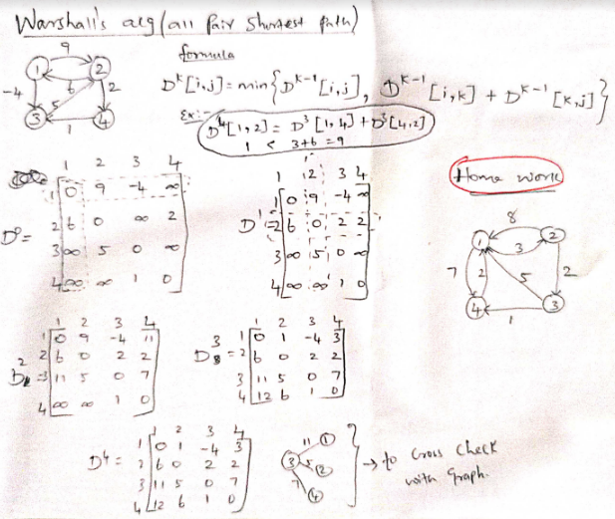
Warshall’s Algorithm -
Example

Slide 45
Unit#3: Nonlinear Data Structure
15
P | 1 | 2 | 3 | 4
1 | 0 | 1 | 1 | 1
2 | 1 | 0 | 1 | 1
3 | 1 | 1 | 0 | 1
4 | 1 | 1 | 1 | 0
1
2
Warshall’s Algorithm
5
5 50
5 15
30
3
4
15

Slide 46
A 1 2 3 4
Unit#3: Nonlinear Data Structure
15
1
2
1
2
3
4
0 | ∞ | 5 | ∞
15 | 0 | ∞ | 5
50 | 5 | 0 | 15
30 | 15 | ∞ | 0
5
5 50
5 15
Modiﬁed Warshall’s Algorithm
30
3
4
15
P
1
2
3
4
D
1
2
3
4
1 2 3 4
1 2 3 4
0 | 1 | 1 | 1
1 | 0 | 1 | 1
1 | 1 | 0 | 1
1 | 1 | 1 | 0
0 | 10 | 5 | 15
15 | 0 | 20 | 5
20 | 5 | 0 | 10
30 | 15 | 35 | 0

Slide 47
Unit#3: Nonlinear Data Structure
th
If D_{k} represents the matrix D after the k iteration , it
can be implemented by:
Modiﬁed Warshall’s Algorithm
D_{k}[i, j] = min (D_{k-1}[i, j], D_{k-1}[i, k]+D_{k-1}[k, j])
We also use a second matrix P, for path, P[i, j] contains the number of the last iteration that caused a change in D[i, j].

Slide 48
Function Warshall(L[1…n, 1…n]) array D[1…n, 1…n], P[1…n, 1…n] P 🡨 0
Unit#3: Nonlinear Data Structure
Modiﬁed Warshall’s Algorithm
D 🡨 L
for k 🡨 1 to n do for i 🡨 1 to n do
for j 🡨 1 to n do
if (D[i, k] + D[k, j] < D[i, j])
then D[i, j] 🡨 D[i, k] + D[k, j] P[i, j] 🡨 k

Slide 49
Unit#3: Nonlinear Data Structure
15
D₀
1
2
3
4
D₁
1
2
3
4
1
2
1 2 3 4
1 2 3 4
0 | ∞ | 5 | ∞
15 | 0 | ∞ | 5
50 | 5 | 0 | 15
30 | 15 | ∞ | 0
5
5 50
5 15
30
Modiﬁed Warshall’s Algorithm
3
4
15
P
1
2
3
4
1 2 3 4
D_{k}[i, j] =
min (D_{k-1}[i, j], D_{k-1}[i, k]+D_{k-1}[k, j])
0 | 0 | 0 | 0
0 | 0 | 0 | 0
0 | 0 | 0 | 0
0 | 0 | 0 | 0

Slide 50
Unit#3: Nonlinear Data Structure
 |  | 15 1 2 | D₄ |  | 1 |  | 2 |  | 3 |  | 4
 |  | 5 | 1 |  | 0 |  | 10 |  | 5 |  | 15
 | 5 | 50 5 15 | 2 |  | 15 |  | 0 |  | 20 |  | 5
 |  | 30 | 3 |  | 20 |  | 5 |  | 0 |  | 10
Modiﬁed |  | 3 ₁₅ 4 | 4 |  | 30 |  | 15 |  | 35 |  | 0
Warshall’s |  |  | P |  | 1 |  | 2 |  | 3 |  | 4
Algorithm |  | D_{k}[i, j] = | 1 |  | 0 |  | 3 |  | 0 |  | 3
 |  | min (D_{k-1}[i, j], D_{k-1}[i, k]+D_{k-1}[k, j]) | 2 |  | 0 |  | 0 |  | 1 |  | 0
 |  |  | 3 |  | 2 |  | 0 |  | 0 |  | 2
 |  |  | 4 |  | 0 |  | 0 |  | 1 |  | 0

Slide 51
Unit#3: Nonlinear Data Structure
Graphs and their understanding
Matrix representations of a given graph
Depth First Search (DFS)
Breadth First Search (BFS)
Minimum Spanning Trees Algorithms (Prims, Kruskal, Dijkstra)
Path Matrix
Warshall’s Algorithm
Till Now
Trees
Graphs

Slide 52
Thank You.
Unit#3: Nonlinear Data Structure

